Slide 1


Estimating Supply and Demand of Light Weight Vehicles in the U.S: A Market Analysis
Donovan Johnson and William Diodato

Slide 2

Background
Over the past two decades, the automobile sector has played a key factor in economic growth. Data indicates that the industry historically contributes nearly 3.5 percent of the total U.S GDP.
3 major reasons for the sectors importance in the economy:
Employment: The sector provides nearly 8 million jobs in various supporting industries. This is 5 percent of all employment in the labor force.
Spending: The sector is a massive consumer in the materials required to manufacture vehicles, inevitably supporting other sectors.
Accessibility/Quality of life: Increased accessibility and quality of life cause an increase in consumer spending.
Due to its importance, companies and policy-makers are interested in better understanding factors impacting the automobile market so they can make informed production-pricing strategies and policy decisions.

Slide 3
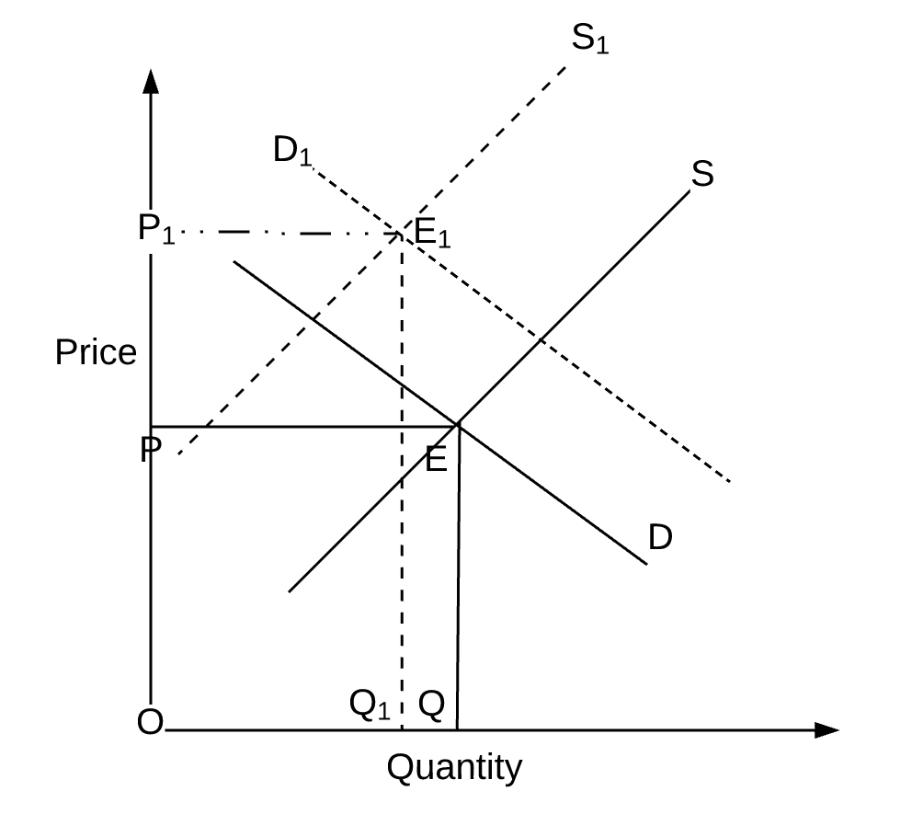
Background (cont.)
Therefore, using market data on vehicle price and quantity sold from January 2014 to July 2021, we will estimate the market demand and supply of light-weight vehicles in the U.S as well as the market equilibrium price and quantity.
Doing so will enable us to identify which exogenous factors, for example, the price of inputs for vehicle production, gas prices, or more, play a role in shifts of market supply and demand.
The technique for estimating market supply and demand functions is a simultaneous equations model.

Slide 4

Data Description
It is reasoned that the demand and supply for vehicles in the U.S. is dependent on:
Price of vehicles
Quantity of vehicles sold
Personal income
Gas prices
Air travel prices
Public transportation prices
The inflation rate
The price of Iron and Steel
The price of Rubber
And more
To approximate such variables, monthly data over an 88-month period is collected from various sources including FRED, Kelly Blue Book, and Statista.
FRED only produces consumer and producer price indices for goods and services, therefore, all variables besides for quantity of vehicles sold and personal income require approximation (proxy variables).
This Photo by Unknown author is licensed under CC BY-NC-ND.

Slide 5
Data Description and Limitations
Proxy/Estimated Variables:
The price of steel/iron, rubber, and gas is proxied by calculating the monthly inflation rate from the CPI/PPI for each respective good or service and then allocating a single month's average price for that good or service. Multiplying the next month's inflation rate by the previous month's price will estimate each month's average prices.
The average quarterly price of air travel is converted to monthly data using a cubic spline interpolation technique.
Omitted/Unobservable Variables:
Data cannot be approximated for average monthly public transportation prices due to the vast differences in each states' public transportation costs and infrastructure.
Using the inflation rate and industry employment variables does not work in the model since its units are not in terms of price.
In an ideal world, the data set would consist of concrete monthly data that did not need to be approximated using the methods discussed above while also consisting of all variables that play a role in changes in the supply and demand of vehicles.
This Photo by Unknown author is licensed under CC BY-NC-ND.

Slide 6




Market Trends for Endogenous Variables (Price and Quantity of Vehicles Sold)
Based on the estimated data, over the past 6 years, car prices have remained relatively stagnant between $30,000-$33,000. However, starting in March 2021, we witness large increases in estimated vehicle price from $33,499.39 to $38,707.02 in July 2021.
The average price of vehicles during this period is $32,310.10 and the average quantity sold is about 1392,000 units. This data is relatively skewed due to the pandemic.
Source: FRED
Source: FRED

Slide 7
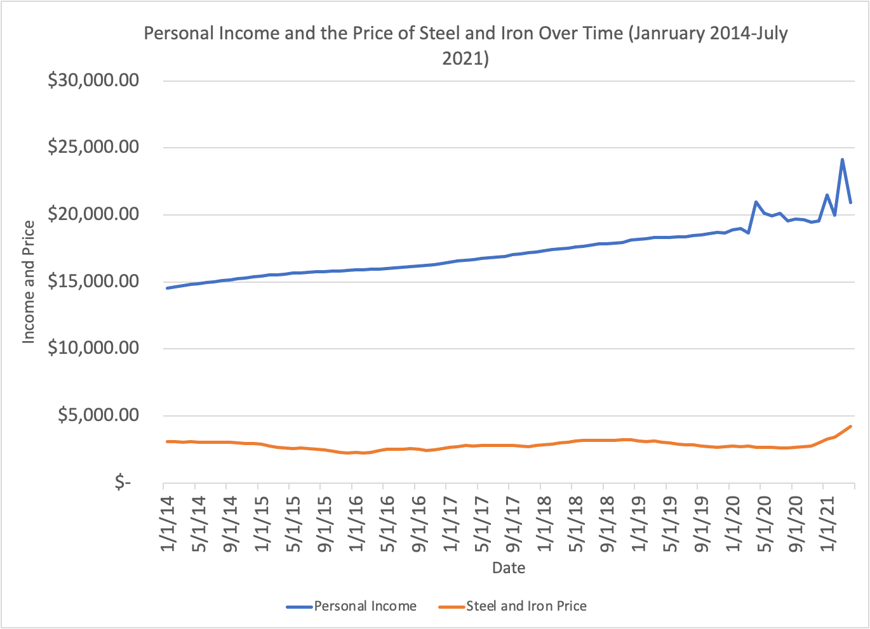
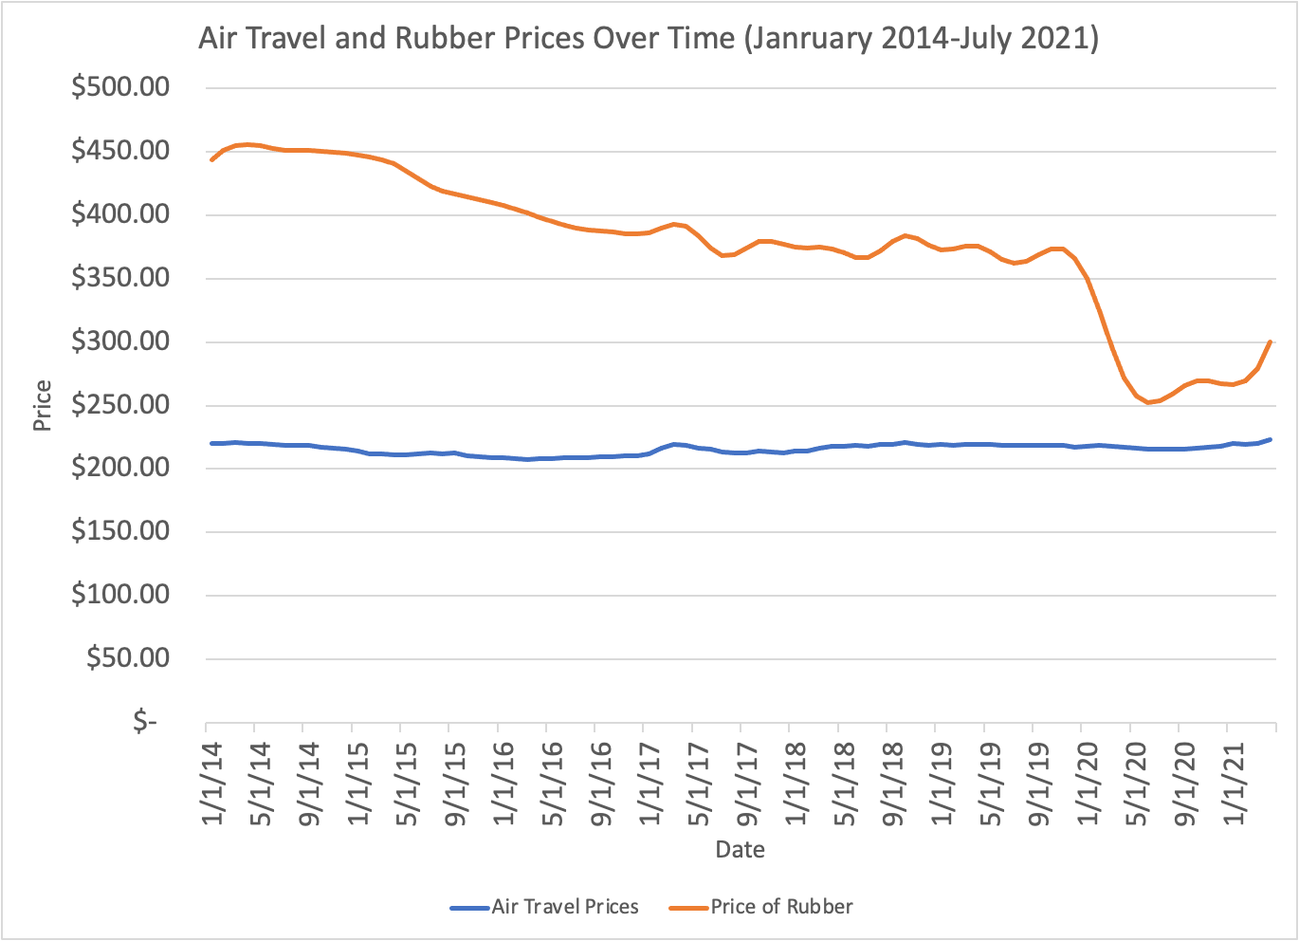
Market Trends for Exogenous Variables
As seen by the two charts, rubber prices in the U.S have consistently decreased since January 2014 with significant decreases during the pandemic period.
The average price of rubber from January 2014-July 2021 is $215.69 per unit which is significantly skewed by low prices during the covid pandemic.
Air travel prices and steel/iron prices have remained relatively constant since January 2014.
The average price of steel/ iron is $2834.45 while the average price of air travel is $377.74 since January 2014
Opposingly, personal Income has consistently increased since January 2014 other than periods of volatility during the Covid pandemic.
Source: FRED
Source: FRED

Slide 8
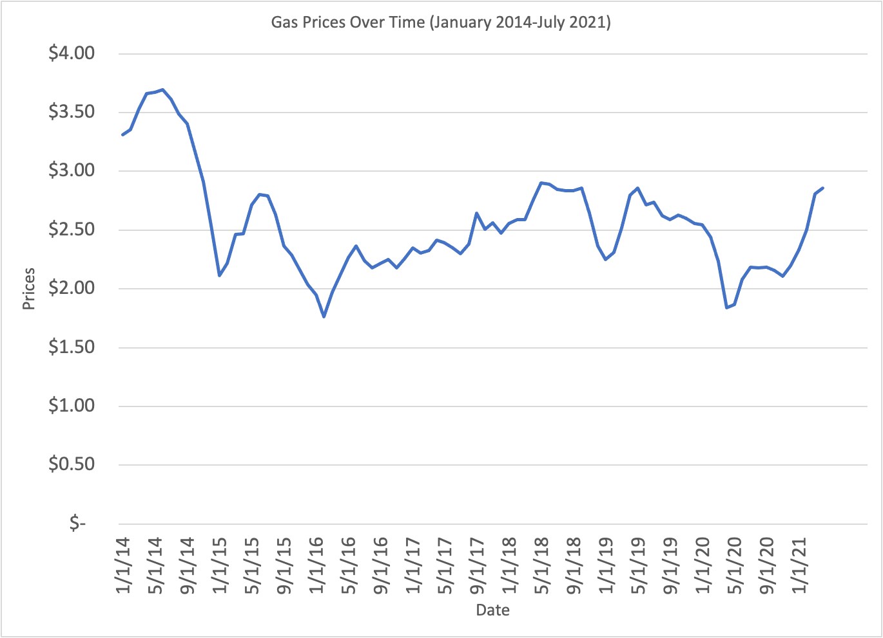
Market Trends for Exogenous Variables (cont.)
Gas prices have been extremely volatile between January 2014 and July 2021. In June 2014, gas prices hit a high of $3.69 while mid 2020 saw an extremely low gas price of $1.84.
The average price of gas over this period is approximately $2.55.
Source: FRED

Slide 9
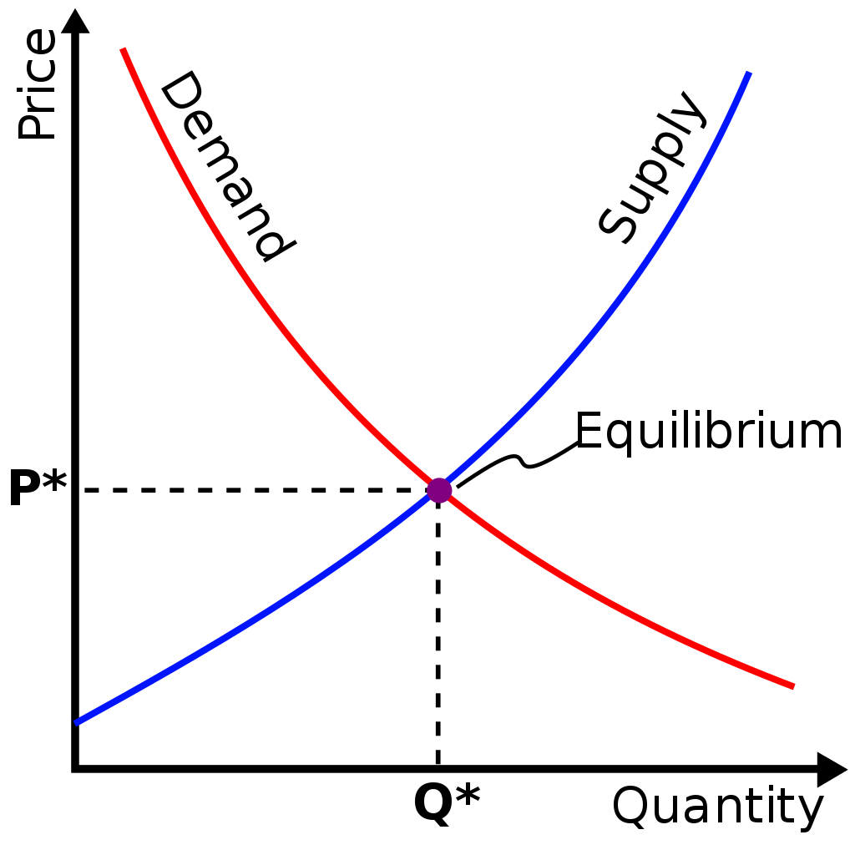
Statistical Model: Simultaneous Equations Model for Supply and Demand Estimates:
What is a simultaneous equations model for supply and demand?
A set of multiple linear regression models that includes two dependent variables (price and quantity) and numerous independent variables (Personal Income, Gas prices, etc.).
What does this show?
Shows the market equilibrium price and quantity of vehicles when Personal Income (PI), Gas Prices (GP), Air Travel Prices (ATP), Steel and Iron Prices (SIP), and Rubber Prices (RP) change.
Shows how the changes described above affect quantity demanded and quantity supplied (estimates the supply and demand functions/curves).
Method choice:
We choose this model as numerous studies have used the same technique for similar problems. For example, Lin (2011) utilizes a simultaneous equations model to estimate demand in the World Oil Market.
This Photo by Unknown author is licensed under CC BY-SA.

Slide 10
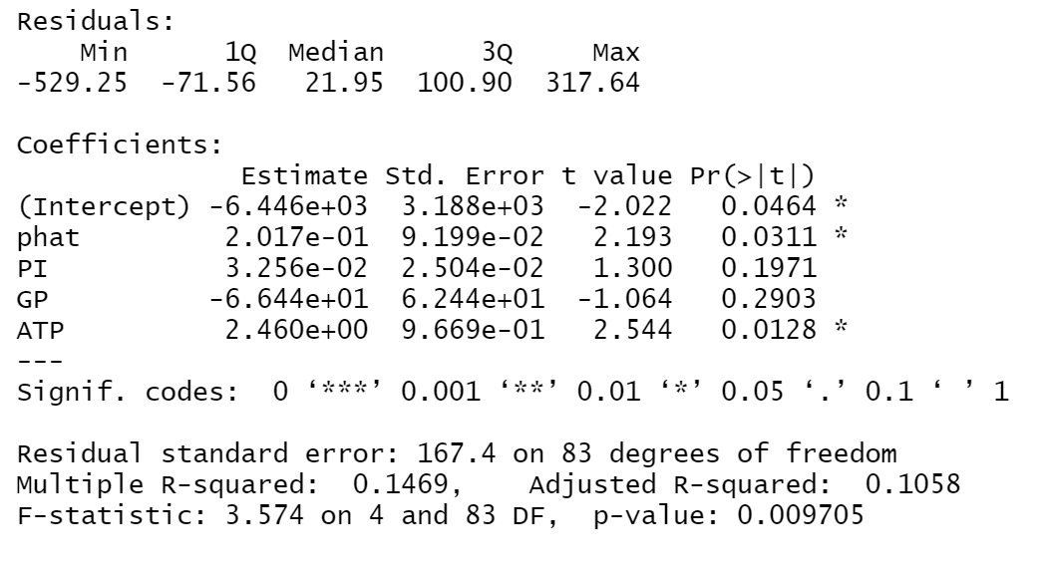
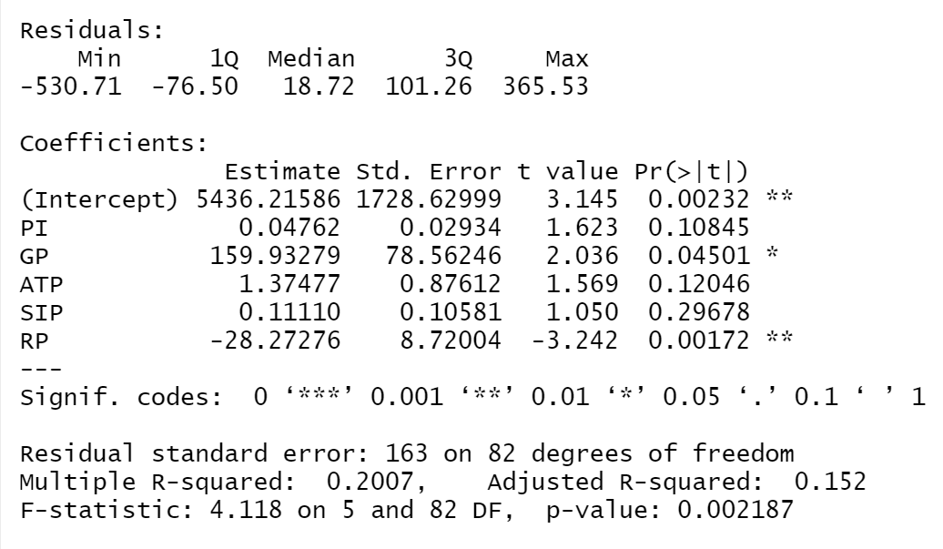
Results
Quantity Linear Model (Graph 1)
The results of our simultaneous equations model are poor estimates of supply and demand, as is the market equilibrium price and quantity of the vehicle market.
When we conduct the linear regression where quantity is dependent on the exogenous variables being studied (Graph 1), we have results that contradict economic theory.
For example, when gas prices increase by 1 unit, the quantity of vehicles sold increases by approximately 160 vehicles. Economic theory suggests that when the price of a complement to vehicles increases, the quantity demanded should decrease.
Our demand function estimate also contradicted economic theory (Graph 2).
For example, a 1 unit increase in the predicted price of vehicles causes an increase in the quantity demand by about 2 units. Based on economic theory, the demand curve should be downward sloping which means an increase in price should decrease the quantity demand.
Demand Linear Model (Graph 2)

Slide 11
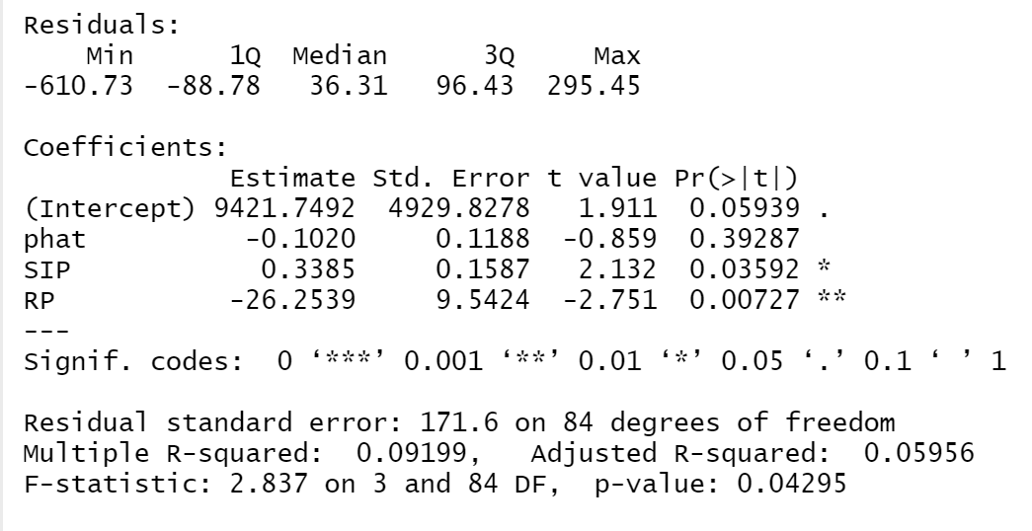
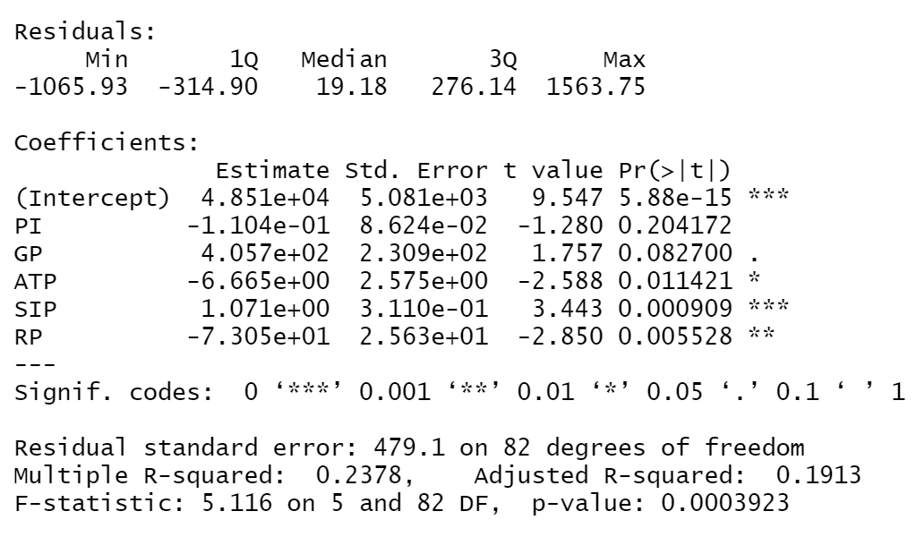
Results (cont.)
Supply Linear Model (Graph 1)
When we conduct the linear regression where the price is dependent on the exogenous variables being studied (Graph 2), we have results that contradict economic theory.
For example, an increase in gas prices by 1 unit should cause the demand for vehicles to decrease, inevitably resulting in a vehicle price decreased, however, our outputs indicate an increase in vehicle price.
Our supply linear model outputs for rubber price would indicate a downward sloping demand curve. This means that price and quantity have a negative relationship. The relationship between price and quantity for supply should be a positive relationship.
Such estimations are a result of data specificity problems
Price Linear Model (Graph 2)

Slide 12

Conclusion
Our problematic results from the simultaneous equations model stem from the market data. With this, we cannot confidently estimate market supply and demand.
This is because the price of vehicles account for the overall price of many different types of vehicles while lightweight vehicles can be numerous models of vehicles. Clearly, this data is too broad, causing the market price and quantity data to be poorly estimated.
To improve this model, we need to get more specific data on the vehicle market. For example, if there is available data on SUV sales and their average monthly price, we could conduct market estimates that are more closely in line with the economic theory of supply and demand.
This would inevitably enable better vehicle market supply and demand estimates.

Slide 13
Appendix

Slide 14
Sources
Producer price index by Commodity: Metals and metal products: Iron and Steel. FRED. (2021, December 14). Retrieved December 15, 2021, from https://fred.stlouisfed.org/series/WPU101
Light weight vehicle sales. FRED. (2021, December 3). Retrieved December 15, 2021, from https://fred.stlouisfed.org/series/LTOTALNSA
Consumer price index for all urban consumers: Used Cars and trucks in West. FRED. (2021, December 10). Retrieved December 15, 2021, from https://fred.stlouisfed.org/series/CUUR0400SETA02
Consumer price index for all urban consumers: Used Cars and trucks in Midwest. FRED. (2021, December 10). Retrieved December 15, 2021, from https://fred.stlouisfed.org/series/CUUR0200SETA02
Consumer price index for all urban consumers: Used Cars and trucks in northeast. FRED. (2021, December 10). Retrieved December 15, 2021, from https://fred.stlouisfed.org/series/CUUR0100SETA02
Consumer price index for all urban consumers: Used Cars and trucks in South. FRED. (2021, December 10). Retrieved December 15, 2021, from https://fred.stlouisfed.org/series/CUUR0300SETA02
Producer price index by commodity: Rubber and plastic products: Rubber and rubber products. FRED. (2021, December 14). Retrieved December 15, 2021, from https://fred.stlouisfed.org/series/WPU071
US regular all formulations gas price. FRED. (2021, December 13). Retrieved December 15, 2021, from https://fred.stlouisfed.org/series/GASREGW
Trading Economics Commodity Data. https://tradingeconomics.com/commodities
“New-Car Transaction Prices down More than One Percent in January 2014, According to Kelley Blue Book.” MediaRoom, https://mediaroom.kbb.com/2014-02-03-New-Car-Transaction-Prices-Down-More-Than-One-Percent-In-January-2014-According-To-Kelley-Blue-Book.
Yobero, Czar. Simultaneous Equation Models: Estimating Supply and Demand Functions, 12 July 2016, http://rstudio-pubs-static.s3.amazonaws.com/195495_d47be7c818424a3c9bfa5452dd17c6c6.html.
Mackay, Alexander, and Nathan H Miller. Estimating Models of Supply and Demand: Instruments and ... 2021, https://www.hbs.edu/ris/download.aspx?name=19-051.pdf.
C.-Y.-C. Lin (2011), ''Estimating Supply and Demand in the World Oil Market,'' the Journal of Energy and Development, Vol. 34, Nos. 1 and 2, 2011., http://www.sciepub.com/reference/16520.
“National-Level Domestic Average Fare Series.” National-Level Domestic Average Fare Series | Bureau of Transportation Statistics, https://www.bts.gov/content/national-level-domestic-average-fare-series.
Hill, Kim, et al. “Contribution of the Automotive Industry to the Economies of All Fifty State and the United States.” Center for Automotive Research, 2 Dec. 2021, https://www.cargroup.org/publication/contribution-of-the-automotive-industry-to-the-economies-of-all-fifty-state-and-the-united-states/.
“The Statistics Portal.” Statista, https://www.statista.com/.

Slide 15
Technical discussion
The Importance of the Model for Market Analysis
Economic theory suggests that the supply and demand of a particular good or service are a function of that good or services' price and other variables that affect supply and demand. When attempting to evaluate real-world market data, we can use this key principle to conduct supply and demand models for the vehicle sector. Market supply and demand modeling are highly important for corporations competing in the vehicle market as it provides insight into production and pricing strategies. Additionally, the vehicle sector competes in an oligopolistic market with differentiated products. Therefore, estimating supply and demand functions using a simultaneous equations model would enable us to conduct further analysis into competitive pricing strategy using a Bertrand model with differentiated products.
Data Description and Limitations:
For this supply and demand analysis, we used monthly data on total lightweight vehicle sales in the U.S, average vehicle price in the U.S, and exogenous variables such as personal income in the U.S. Many of our exogenous variables, including one of our two endogenous variables, the average price of vehicles in the U.S, required approximation. The price of rubber, and steel/iron needed to be proxied by collecting the monthly producer price index on rubber, steel, and iron, and calculating the goods' monthly inflation rate by finding the percent change from one month to the next. We then identified the current trading price of each commodity and multiplied it by the inflation rate of the previous month which estimated the average price of each commodity. Furthermore, to estimate average air travel prices in the U.S, we are required to convert the Bureau of Transportation's data on quarterly air travel prices to monthly prices using a cubic spline interpolation in Matlab. A sample of these processes is provided on the spreadsheets in the proceeding slides.
While there is an abundance of data on total vehicle sales and indices that provide price and income estimations, there is minimal data on specific model sales, for example, SUV sales and those models' average price. Due to this data specificity problem for quantity of vehicles sold and their price, we are getting inaccurate estimates of the entire vehicle markets supply and demand. Fixing this problem would entail finding data a specific car model and its average monthly price and quantity.

Slide 16
Technical Discussion (cont.)
A Simultaneous equations model for supply and demand estimates
A simultaneous equations model can estimate market supply and demand, providing insight into market equilibrium supply and demand. To create this model, we must take the necessary steps to find the structural form of the 2-stage least squares estimation. The first stage is to find the reduced parameters by conducting 2 linear regression models where quantity and price are dependent on the exogenous variables being observed (Personal Income, Air Travel Prices, Gas Prices, Rubber Prices, and Steel/Iron Prices). Such linear models will provide details on the effects of an exogenous price change on the market equilibrium price and quantity. Finding the fitted values of the price reduced parameters linear model gives us a predicted value of price which can now be used as an independent variable for the demand and supply linear models. These supply and demand models are determined by the 2 structural form equations (stage 2) where the quantity demanded, and quantity supplied is dependent on the predicted price of vehicles among the other exogenous variables. The structural form equations show the effects of changes in the exogenous variables, which now include the predicted values of price, on the quantity demanded and quantity supplied. Once the supply and demand equations are created, we can estimate the points at which the demand and supply curves intersect for equilibrium analysis. Beyond this, we can evaluate changes in each variables' coefficient. This will determine how shifts in the supply or demand curve, as a result of changes of exogenous variable price, affect the market equilibrium price and quantity. The R code for this model is provided on the proceeding slides.

Slide 17
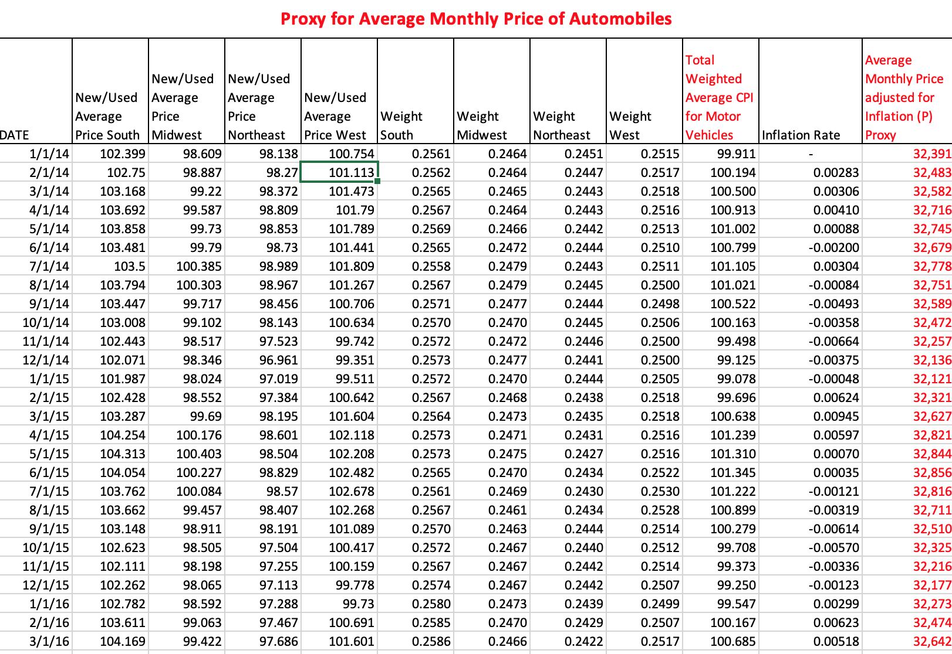
A Proxy for Average Vehicle Price
A sample of the spreadsheet

Slide 18
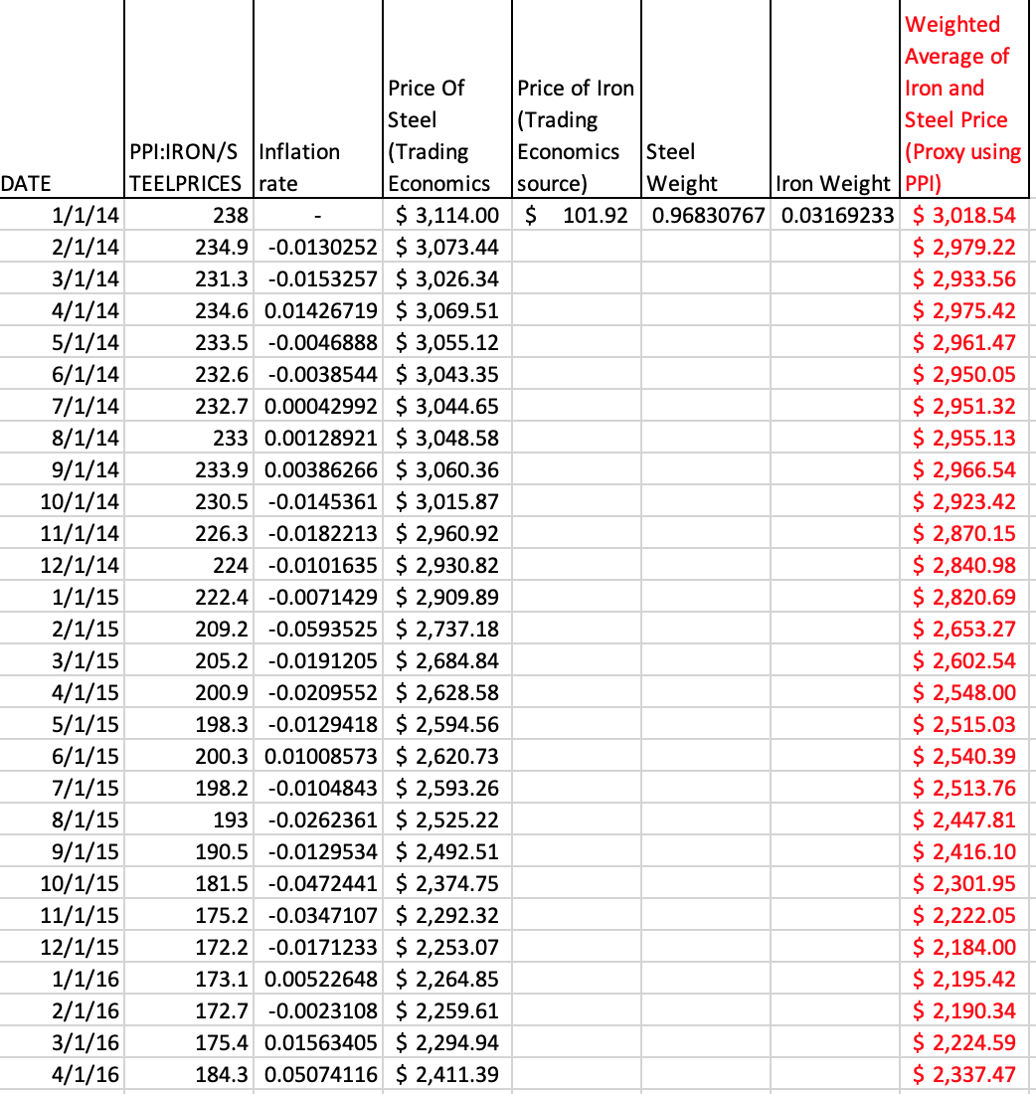
A Proxy for Average Iron/Steel Price
A sample of the spreadsheet

Slide 19
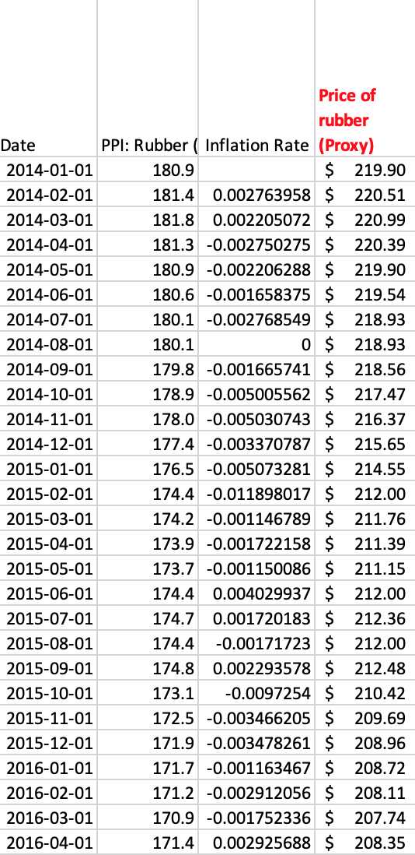
A Proxy for Rubber Prices
A sample of the spreadsheet

Slide 20
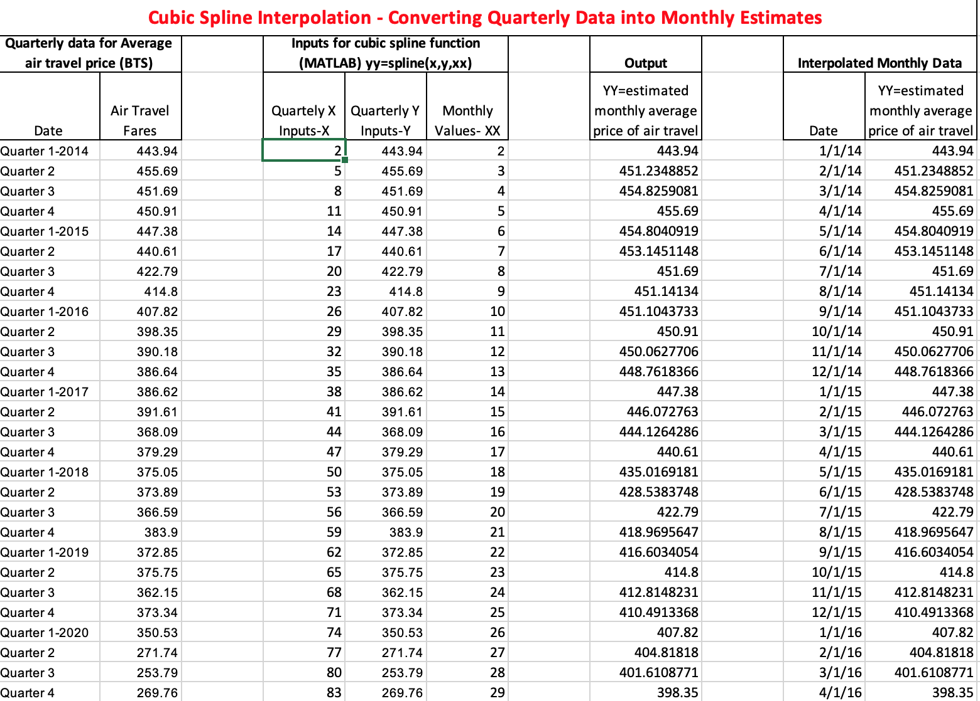
An Estimate for Monthly Air Travel Prices: Cubic spline Interpolation (Matlab)
A sample of the spreadsheet

Slide 21
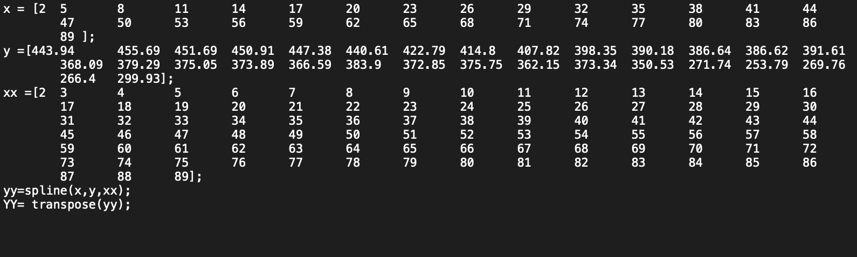
Cubic Spline Interpolation Matlab Code

Slide 22
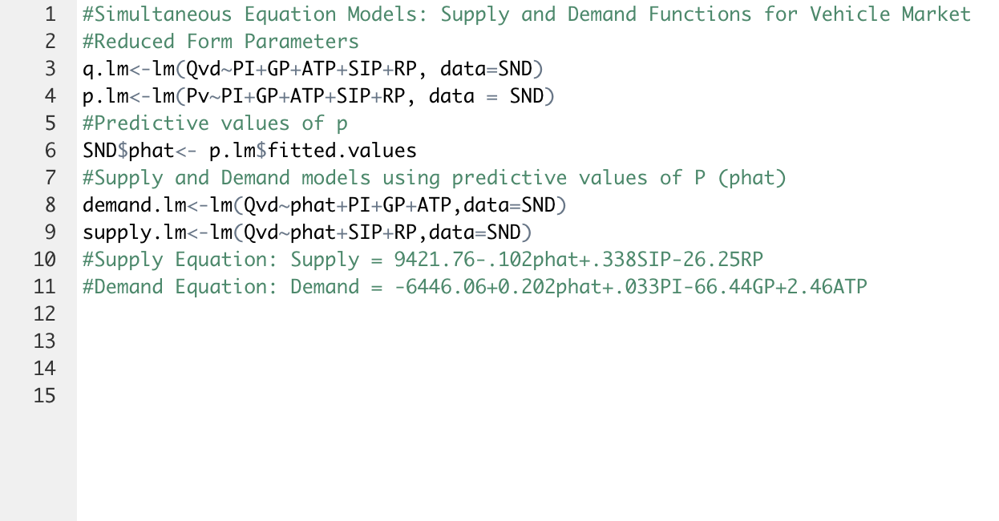
R code: Simultaneous Equations Supply and Demand Model

Slide 23
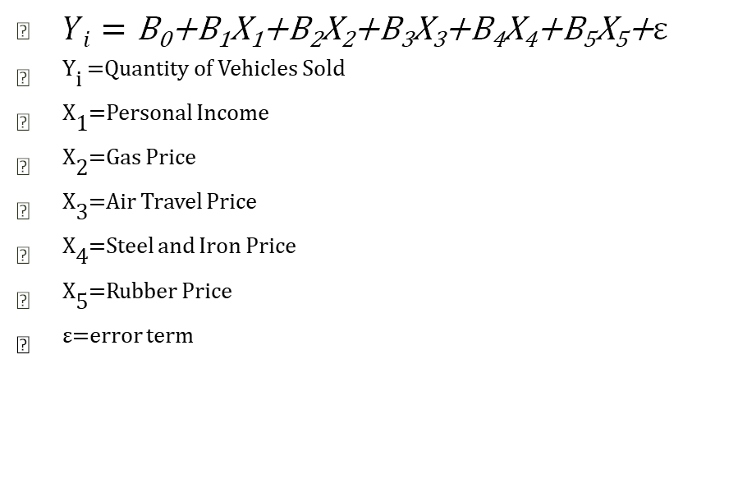
Quantity Linear Model and Summary Statistics
R code:
$Yi=\text{B}\text{0}\text{+}\text{B}\text{1}\text{X}\text{1}\text{+}\text{B}\text{2}\text{X}\text{2}\text{+}\text{B}\text{3}\text{X}\text{3}\text{+}\text{B}\text{4}\text{X}\text{4}\text{+}\text{B}\text{5}\text{X}\text{5}\text{+}ε$
^{Y}i ^{=Quantity of Vehicles Sold}
^{X}1^{=Personal Income}
^{X}2^{=Gas Price}
^{X}3^{=Air Travel Price}
^{X}4^{=Steel and Iron Price}
^{X}5^{=Rubber Price}
^{ε=error term}

Slide 24
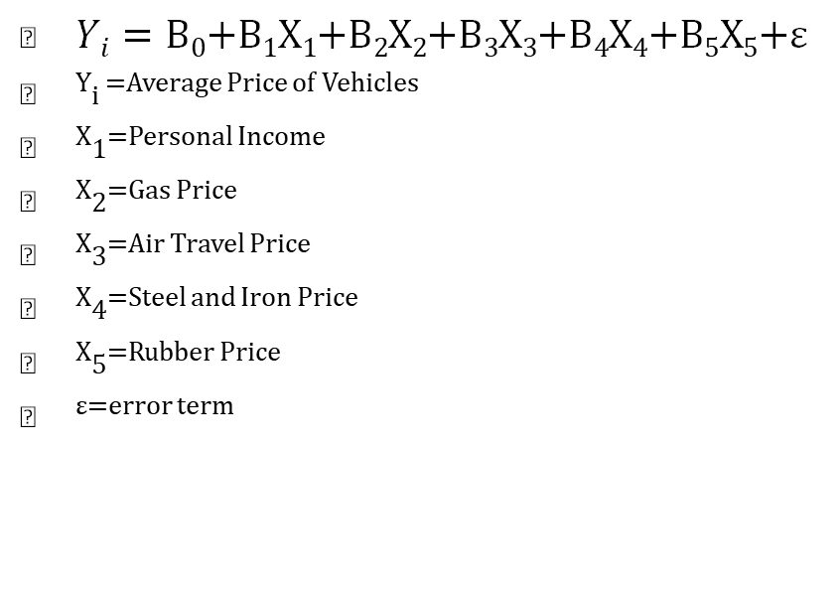
Price Linear Model and Summary Statistics
R code:
$Yi=\text{B}\text{0}\text{+}\text{B}\text{1}\text{X}\text{1}\text{+}\text{B}\text{2}\text{X}\text{2}\text{+}\text{B}\text{3}\text{X}\text{3}\text{+}\text{B}\text{4}\text{X}\text{4}\text{+}\text{B}\text{5}\text{X}\text{5}\text{+}ε$
^{Y}i ^{=Average Price of Vehicles}
^{X}1^{=Personal Income}
^{X}2^{=Gas Price}
^{X}3^{=Air Travel Price}
^{X}4^{=Steel and Iron Price}
^{X}5^{=Rubber Price}
^{ε=error term}

Slide 25
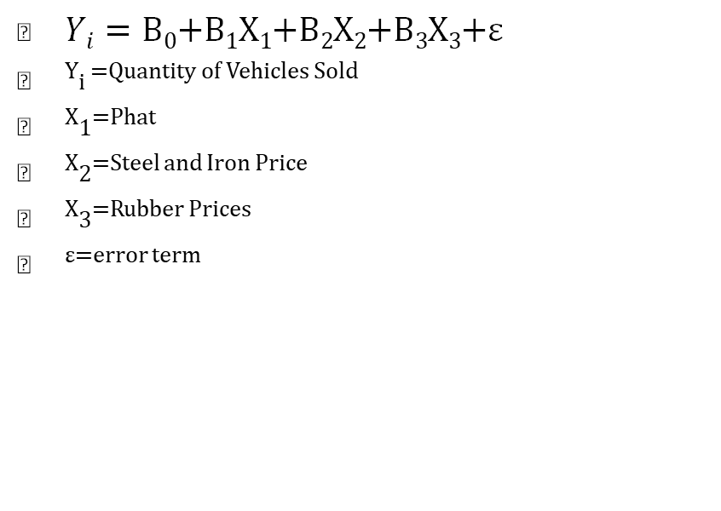
Supply Linear Model and Summary Statistics
R code:
$Yi=\text{B}\text{0}\text{+}\text{B}\text{1}\text{X}\text{1}\text{+}\text{B}\text{2}\text{X}\text{2}\text{+}\text{B}\text{3}\text{X}\text{3}\text{+}ε$
^{Y}i ^{=Quantity of Vehicles Sold}
^{X}1^{=Phat}
^{X}2^{=Steel and Iron Price}
^{X}3^{=Rubber Prices}
^{ε=error term}

Slide 26
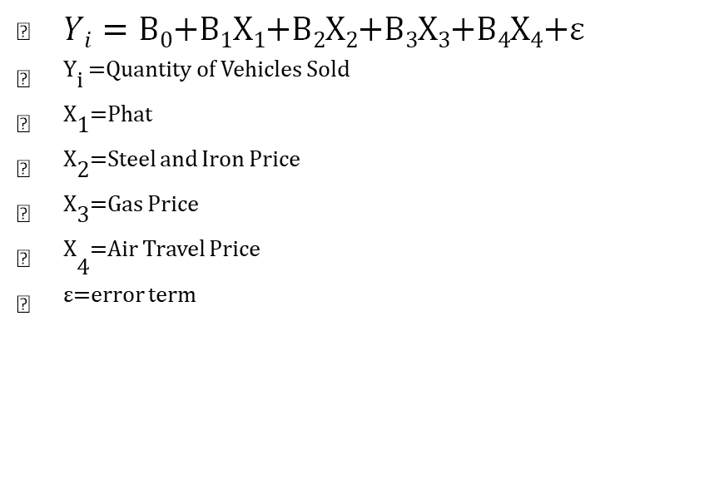
Demand Linear Model and Summary Statistics
R code:
$Yi=\text{B}\text{0}\text{+}\text{B}\text{1}\text{X}\text{1}\text{+}\text{B}\text{2}\text{X}\text{2}\text{+}\text{B}\text{3}\text{X}\text{3}\text{+}\text{B}\text{4}\text{X}\text{4}\text{+}ε$
^{Y}i ^{=Quantity of Vehicles Sold}
^{X}1^{=Phat}
^{X}2^{=Steel and Iron Price}
^{X}3^{=Gas Price}
^{X}₄^{=Air Travel Price}
^{ε=error term}

